Slide 1
Tangerines
By Team Tangerine

Slide 2
Contact Information
Team Members:
Name | Email
Michael Reynolds | Reynomo@mail.uc.edu
Sujay Dammoju | Dammojsy@mail.uc.edu
Ragu Neopaney | Neopanru@mail.uc.edu
Khoa Do | Dokd@mail.uc.edu

Slide 3
Project Purpose and Goal Statements
Purpose:
To create a fun web application game that demonstrates our knowledge of web development and game development.
Goal Statements:
Learn about various aspects of web development
Develop a user-friendly application that is easy to navigate
Create a fully functional game that meets all standards of the game

Slide 4
Project Abstract
Our product should look like is a web page with a score on it and the game underneath. The game will have five pots at the bottom of the column and 5 rows of leaves making a 5x5 grid. The objective of the game will be to flip over the leaves and avoid flipping over a leaf that had a exploding(red) tangerine behind it. There will be clues on each of the pots and end of the rows that tell you the point value of the row and how many exploding tangerines are on each row. When flipping over a leaf (one square of the 5x5 grid) you will either get a red, green, orange, or gold tangerine. Red tangerines end the game. Green tangerines are worth 1, orange tangerines are worth 2 and gold tangerines will be worth 3. The points will be multiplicative, as in every time you get a tangerine, it gets multiplied to your current score.

Slide 5
User stories
As a user, I would like to be able to navigate the site and play a functioning game of Tangerines.
As a user, I would like to be able to see my score as I am playing a game of Tangerines.
As a user, I would like to navigate the game with arrow keys along with point and click.
As a user, I would like to save my score at the end of the game to keep track of the leaderboard.

Slide 6

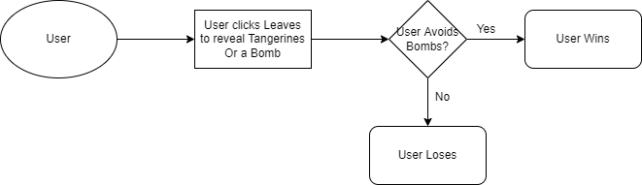
Design Diagrams

Slide 7
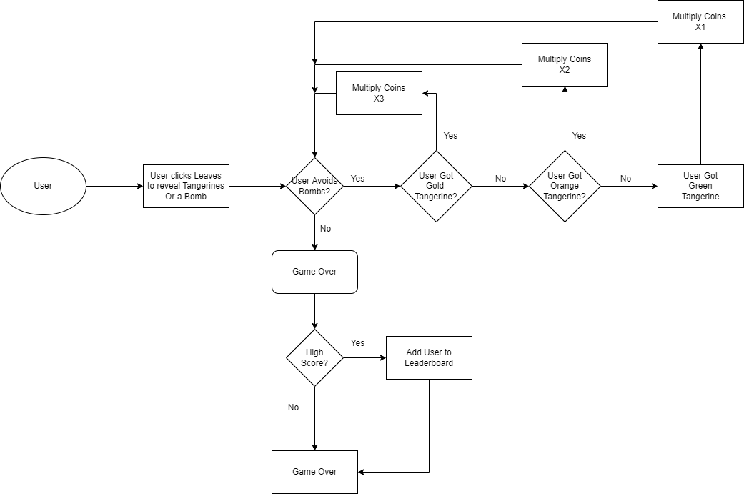
Design Diagrams Cont.

Slide 8
Review of Current Progress
We have a set schedule of when the tasks are to be completed
We have assigned roles to each team member
We have started the research cloud functionalities for a leaderboard

Slide 9
Expected Accomplishments for the end of this term
Have all requirements and specifications done
Have all of the major functionality of the project code ready
Decided on tech stack to use for the coding

Slide 10
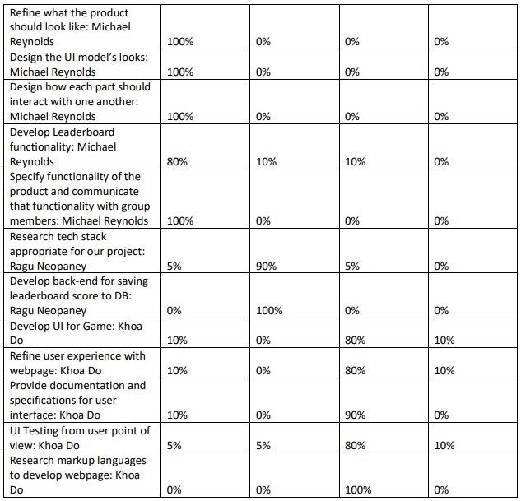
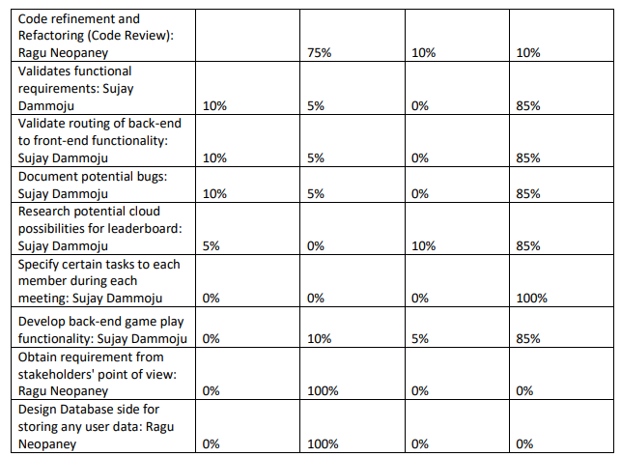
Division of Work

Slide 11
Expected Demo at Expo
Talk about the tech stack used to create the application
A playthrough of the game demonstrating:
Levels
Leaderboard
Rules for the game
A win/loss

